Slide 1
Random graphs with general degree distributions (Configuration model)

Slide 2
Review of (moment) generating function
Given a probability distribution p_{k}, the (moment) generating function is the following polynomial

Slide 3
Example 1
Suppose that the random variable only takes the values 0,1,2,3 with probabilities p₀, p₁, p₂, and p₃.

Slide 4
Poisson distribution

Slide 5
Exponential distribution
Exponential distribution (geometric distribution)

Slide 6
Power-law distribution

Slide 7
Normalization and moments
For a probability distribution,

Slide 8
Moments

Slide 9
Powers of generating functions
Suppose

Slide 10
A property of generating functions
Let Y be the sum of i.i.d. random variables, i.e.
Let the probability generating functions of X_{i} and Y be g(z) and h(z).

Slide 11
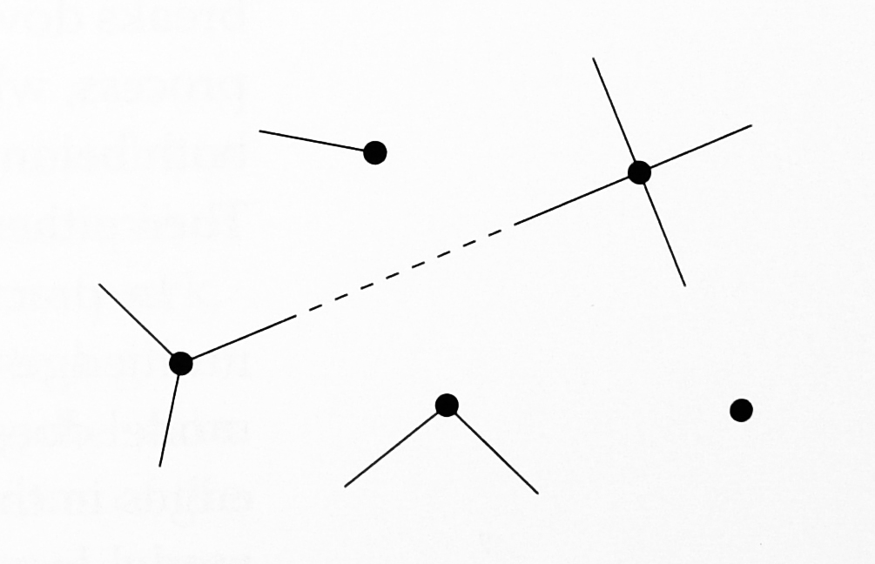
The configuration model
Given a specific degree sequence
Give vertex i k_{i} “stubs”
Choose two of the stubs uniformly at random and create an edge between the two vertices of the two chosen stubs. (they might be the same vertices (self edges))
Repeat the process until all the stubs are chosen.

Slide 12
Degree sequence: 0, 1, 2, 3, 4
The sum is an even number

Slide 13
Matching
The end result is a matching of the stubs (a particular set of pairing of stubs with other stubs)
(Uniform distribution) The process generates every matching with equal probabilities.
Number of matchings:

Slide 14
Issues
The sum of the degree sequence must be an even number.
There are self-edges and multiedges. (Cannot be removed without violating the uniform distribution property).
Not all networks appear with equal probabilities (even though all matchings appear with equal probability).

Slide 15
The probability of chosen a network with the adjacency matrix A
Need to count the number of matchings corresponds to a network with a specific adjacency matrix.
The number of permutations of the k_{i} stubs at vertex i is k_{i}!.
Each network occurs with probability

Slide 16
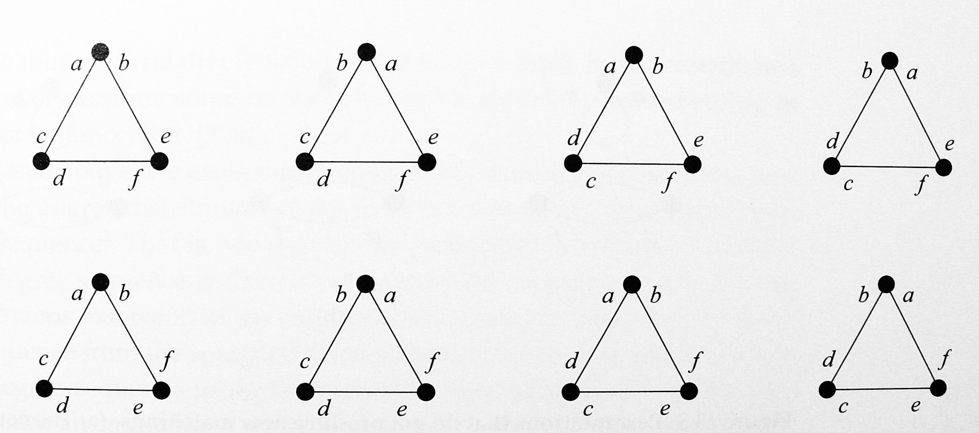
Eight stub matchings that all give the same network

Slide 17
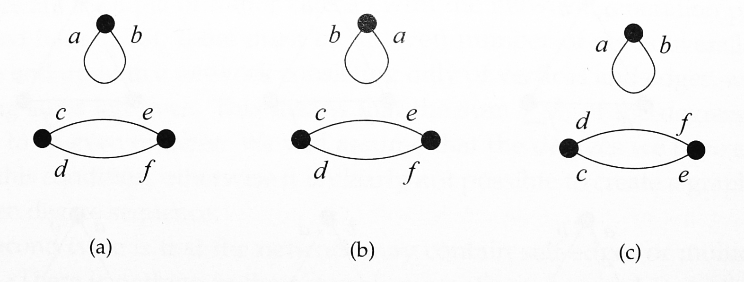
Permutations that do not produce a new matching
A_{ii} is twice of the number of self-edges of vertex i

Slide 18
From degree sequence to degree distribution
Specify the degree distribution p_{k}
Draw a degree sequence k₁,k₂, … with probability
Then use the degree sequence to generate a random graph via using the configuration model.

Slide 19
Edge probability
The probability that a stub of vertex i is connected to a stub of vertex j is k_{j}/(2m-1) as we choose the stubs uniformly from the remaining 2m-1 stubs)
The probability that there is an edge between vertex i and j is
Technically, this is the average number of edges between vertex i and vertex j. (Note that the probability of having more than two edges is O(m⁻²). This is similar to what we have for Poisson process)

Slide 20
Edge probability
For large m, we simply ignore -1 and write
The probability of having two edges between the same pair of vertices i and j

Slide 21
The expected total number of multiedges remains constant

Slide 22
Another way to derive the edge probability
For two vertices i and j, there are k_{i} k_{j} possible ways of connecting them in the configuration model.
There are ways of choosing a pair of stubs.
The probability of throwing an edge in the graph and that edge is between vertices i and j is
As there are m edges in total, the expected number of edges between vertices i and j is

Slide 23
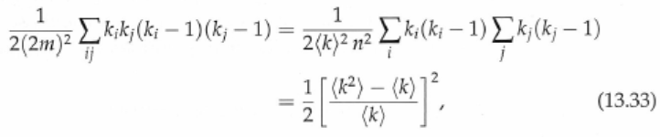

The expected total number of multi-edges
Division by two to avoid double counting of vertex pairs

Slide 24
Edge probabilities for self-edges
For self-edges, the number of ways to connected the two stubs of vertex i is
The probability that there is a self-edge at vertex i is then
The density of self-edges vanishes as 1/n in the limit.

Slide 25
The expected number of common neighbors of i and j
A vertex is a common neighbor of i and j if there is an edge between i and and another edge between j and
The probability that vertex is a common neighbor of i and j is
The expected common neighbors of i and j is

Slide 26
13.3 Excess degree distribution

Slide 27
Consider a configuration model with degree distribution p_{k}
This is the probability that a vertex chosen randomly and uniformly from the network has degree k
Suppose that we take a vertex (randomly or not) and follow one of its edges (assuming that it has at least one) to the vertex at the other end.
What is the probability that the other vertex has degree k?

Slide 28
This probability can be derived by the concept of stubs.
An edge emerging from a vertex in a configuration model has equal chance of terminating at any stub of an edge anywhere else in the network.
There are 2m stubs in total, or 2m-1 excluding the one at the beginning of our edge, any k of them are attached to any particular vertex with degree k.

Slide 29
2m-1
Our edge has probability k/(2m-1) of ending at any particular vertex of degree k.
As m is large, this probability is approximately equal to k/(2m).
The probability of our edge attaching to any vertex with degree k is

Slide 30
This phenomenon is called sampling bias.
The vertex reached by following an edge is not a typical vertex.
It is more likely to be high degree vertex than a typical vertex.

Slide 31

Some counter-intuitions
Consider a randomly selected vertex in the configuration model.
  Let us calculate the average degree of a neighbor of that vertex
The average degree of a neighbor is different from the average degree

Slide 32

The difference is non-negative
In colloquial terms, “Your friends has more friends than you do.”
Why?
  There are certainly some neighbors in the network with higher degree than the average.
  There are also neighbors with lower degree than average.
  Why not cancel out?

Slide 33
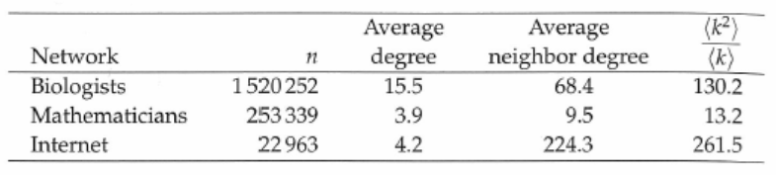
This formula works very well even in real-life networks.
For example, consider two academic collaboration networks

Slide 34
The fundamental reason
Suppose that one walks through the vertices in the network and average the degrees of the neighbors of each one.
Vertices with high degrees are visited more often.
  They are over represented in the calculation compared with low-degree ones.

Slide 35

Excess degree
The number of edges attached to a vertex other than the edge we arrived along is called the excess degree of the vertex.
The probability of q_{k} of having excess degree k is

Slide 36
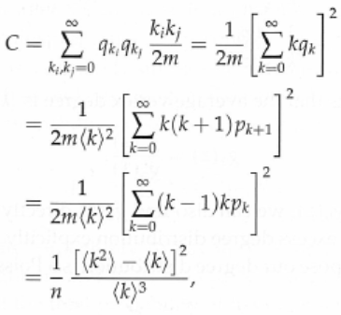
13.4 Clustering coefficient
The clustering coefficient is the probability that a connected triple is a triangle

Slide 37
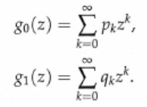
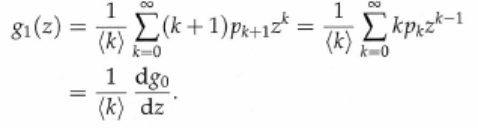
13.5 Generating functions for degree distributions
Let g₀(z) and g₁(z) be the generating functions for the degree distribution and the excess degree distribution
These two generating functions are not independent

Slide 38
Since
Thus

Slide 39





From g₀(z) we can find g₁(z).
For example,

Slide 40

13.6 Number of second neighbors of a vertex
P_{k}⁽²⁾ : probability that a vertex has exactly k second neighbors
p⁽²⁾(k|m) is the probability of having k second neighbors given that there are m first neighbors

Slide 41
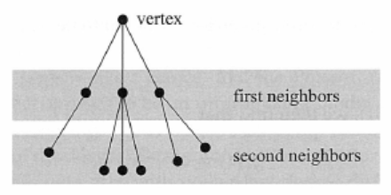
A
Consider vertex A
Let X be the degree of A. Let the X first neighbors of A be denoted by
Let Y_{i} be the excess degree of B_{i} , ie B_{i} has Y_{i} edges excluding the edge between A and B_{i}

Slide 42
The number of second neighbors of A is W, where
This calculation assumes that first neighbors do not have common second neighbors. Indeed, this probability approaches zero as n becomes large.

Slide 43
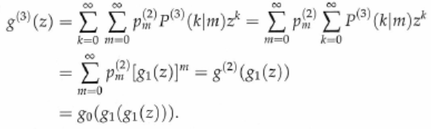
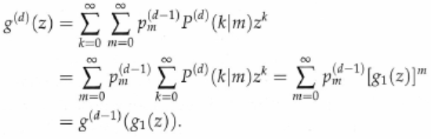
Generating function of the number of third neighbors
Generating function of the neighbors at distance d

Slide 44


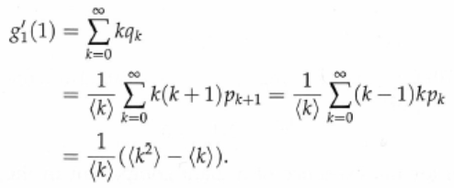

Expected number of neighbors at distance d

Slide 45


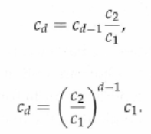

The average number of neighbors at distance d either grows or falls off exponentially, depending on c₂ is greater or less than c₁
There is a giant component if and only if c₂ > c₁, or
Molloy and Reed

Slide 46

13.7 Generating functions for the small components
Similarly to Poisson random graphs, configuration models have one giant component and several small components
Let π_{s} be the probability that a randomly chosen vertex belongs to a small component of size s
We analyze π_{s} by calculating its generating function, i.e.

Slide 47
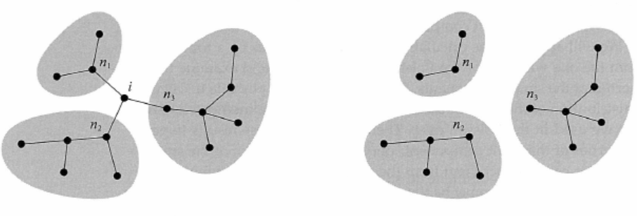
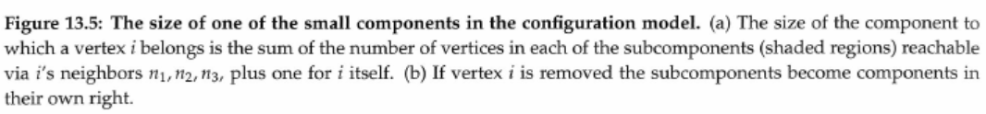
By an argument used for Poisson random graphs, we argue that the small components in the configuration model are trees

Slide 48


The shaded areas must have different sizes.
Let their sizes be distributed according to ρ_{s} and let
Let the degree of vertex i be k and let P(s|k) be the probability that, after i is removed, its k neighbors belong to small components of sizes summing to exactly s
P(s-1|k) is the probability that i itself belongs to a small component of size s given that its degree is k. Then,

Slide 49
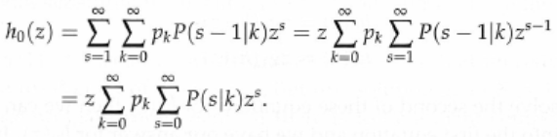




Remove vertex i, and
Taking transform, we have
Hence,

Slide 50


Slide 51


13.8 Giant component
h₀(1) may not equal to 1
Let S be the fraction of vertices belonging to a giant component
Define u=h₁(1)

Slide 52
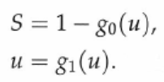
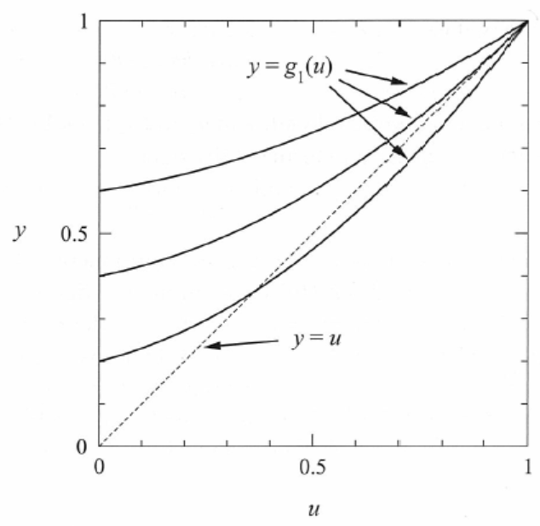
Rewrite the previous two equations
u is a fixed point
of the function g₁(z)

Slide 53
If u=1 is the only fixed point, then S=0 meaning that there is no giant component
The following is an argument to derive
To belong to the giant component, a vertex A must be connected to the giant component via at least one of its neighbors
Let us define u to be the average probability that a vertex is not connected to the giant component via its connection to some particular neighboring vertex.
If vertex A has k neighbors, then the probability that is not connected to the giant component is u^{k}

Slide 54


The average of this probability over the whole network is
This is the probability that a vertex is not in the giant component.
By definition, this probability is also 1-S. Thus,
By the same argument, we derive u=g₁(u)
The probability that A is not connected to the giant component via a particular neighbor is equal to the probability that A is not connected to the giant component via any of the neighbors of that neighbor.
If that neighbor has k neighbors, this probability is u^{k}

Slide 55


The probability that a particular neighbor has k neighbors excluding vertex A is q_{k}
Thus,

Slide 56
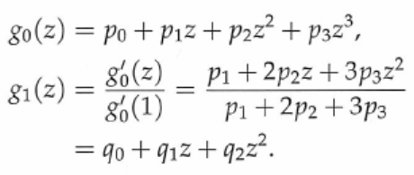


13.8.1 Example

Slide 57

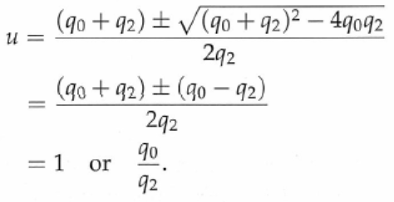


But,
If q₂ > q₀, we have a non-trivial fixed point and

Slide 58

13.8.2 Graphical solutions and the existence of the giant component
There is a non-trivial fixed point if

Slide 59
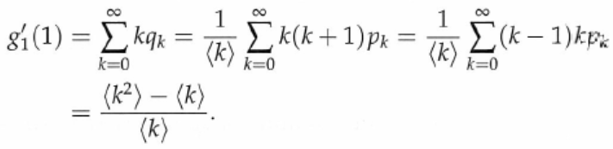


Molloy and Reed
The condition for the existence of non-trivial fixed point is the same that that for the existence of a giant component

Slide 60
13.9 Size distribution for small component

Slide 61


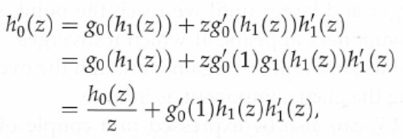

Calculation of <s>
The mean size of the component to which a randomly chosen vertex belongs is

Slide 62

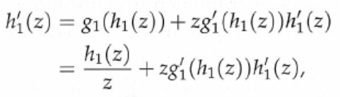



To compute h₁’(1), we differentiate

Slide 63




In a special case where S=0 and u=1, we have
Two equivalent forms

Slide 64


13.9.1 Average size of a small component
The mean ‹s› is the average size of a component which a randomly chosen vertex belongs
It is not the average size of a component
  More vertices belong to larger components, which biases the value of ‹s›
The sum in the denominator can be evaluated

Slide 65
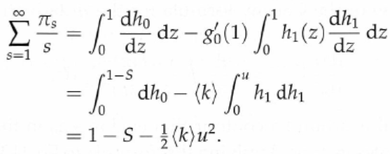


Note that the value of R at the transition point where S=0 and u=1 is finite, ie.

Slide 66


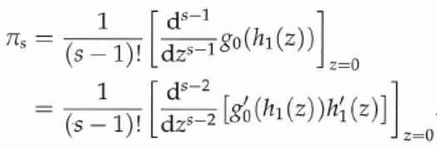
13.9.2 Complete distribution of small component sizes
One can recover probabilities π_{s} from h₀(z), where

Slide 67



Cauchy formula
  The above integral is around a contour that encloses z₀ and contains no poles of f(z)
Let z₀ =0 and the contour be an infinitesimal circle around the origin
Change the integration variable to h₁

Slide 68
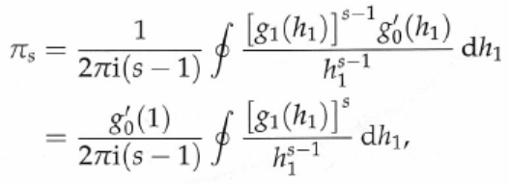



Slide 69




An example: Poisson random graph

Slide 70
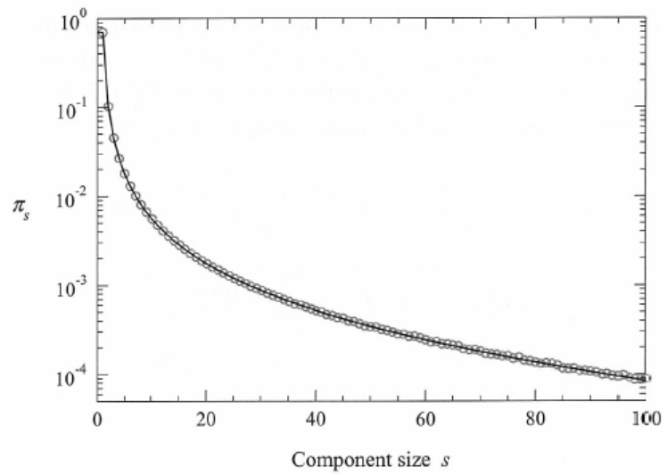

Slide 71


13.10 Power-law degree distributions
Power law degree distribution
Riemann zeta function

Slide 72




The network has a giant component if
The first and the second moments of power-law degree distributions are
There is a giant component if

Slide 73
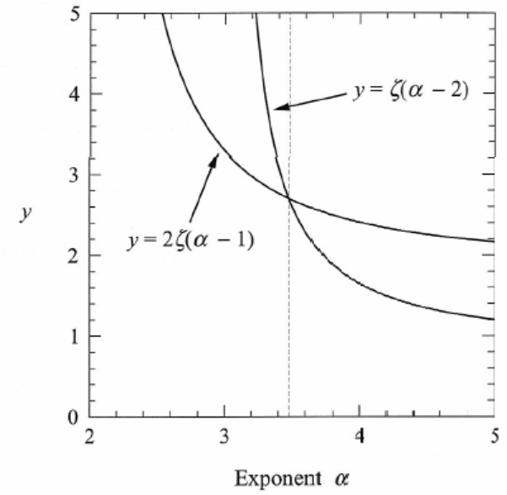
The cross-over occurs at α=3.4788
The network has a giant component if α<3.4788

Slide 74
13.11 Directed random graphs
Section 13.11 is skipped

Slide 75
List of notations

